Slide 1
exploAR: Sprint 1
Adithya Raghuraman, Jack Dangremond, Varun Raghav Ramesh

Slide 2
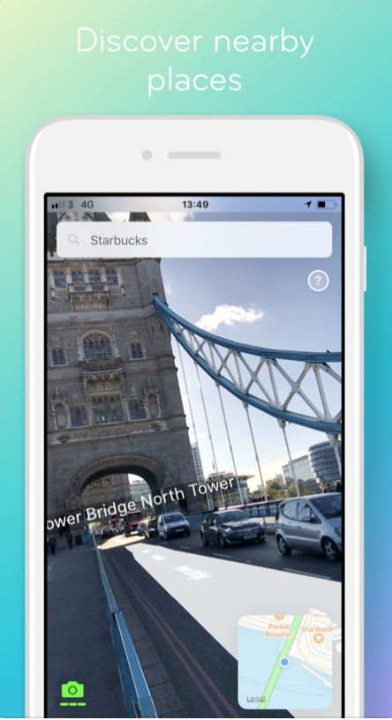
Project Background
AR-enabled maps app
Discover places
Information on the go
Improved UX
Courtesy: ARCity iOS

Slide 3



The exploAR Team
Jack Dangremond
Sprint 1 Manager
Adithya Raghuraman
Sprint 2 Manager
Varun Raghav Ramesh
Final Sprint Manager

Slide 4
Goals for Sprint 1
Product owner: Jack Dangremond
Setup project structure
Obtain information from Google Places API - Adithya
Get user location - Jack & Varun
Follow AR Tutorial and display places of interest in AR - Jack & Varun
Enable communication between frontend and backend - Varun
Deploy to AWS - Adithya

Slide 5
Demo

Slide 6
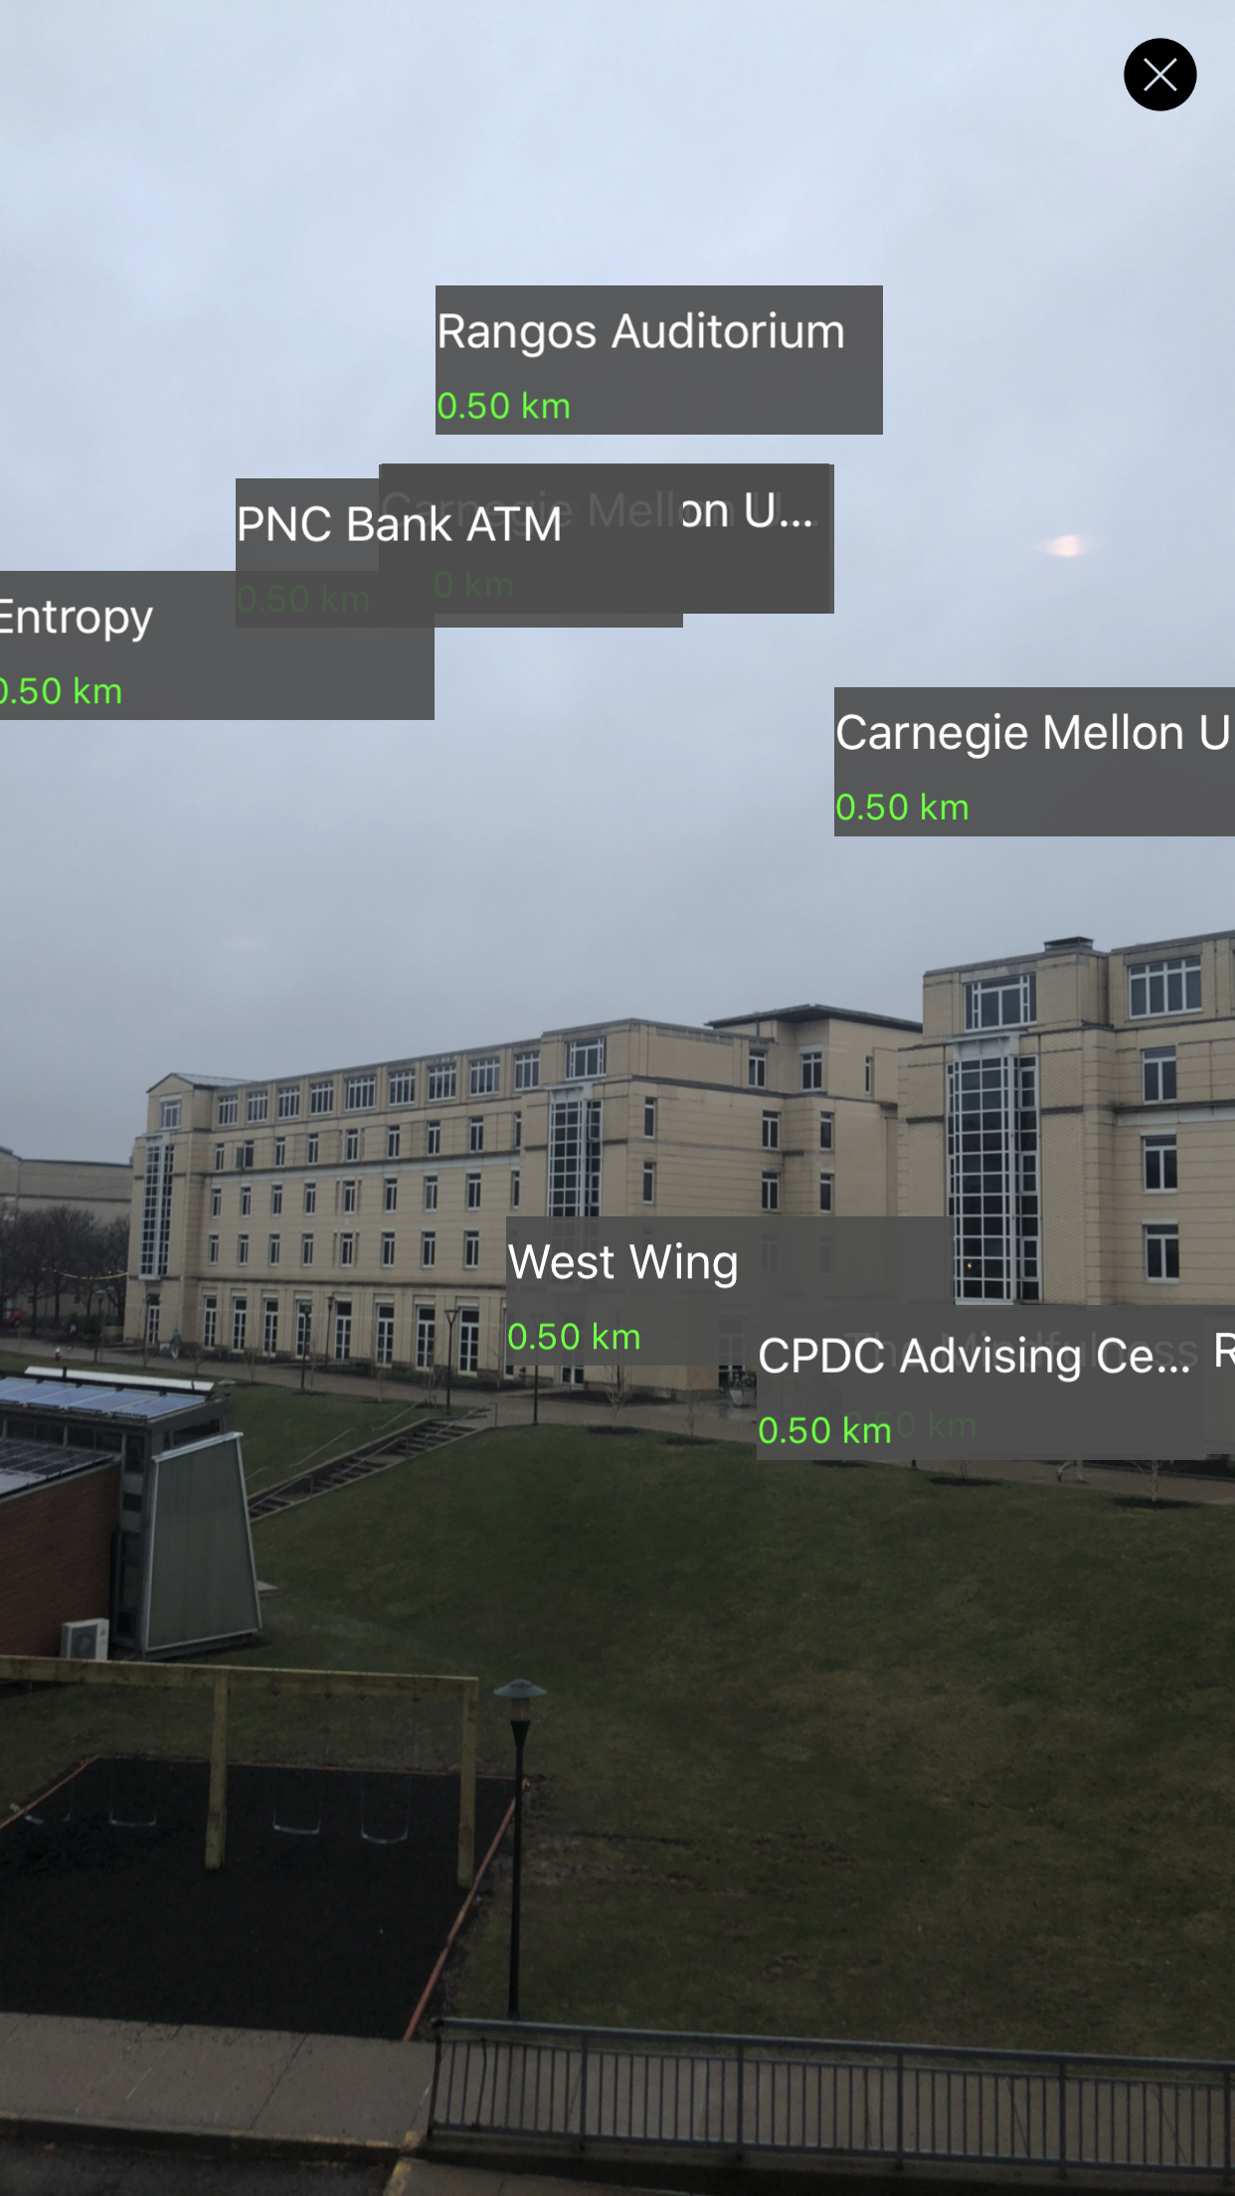
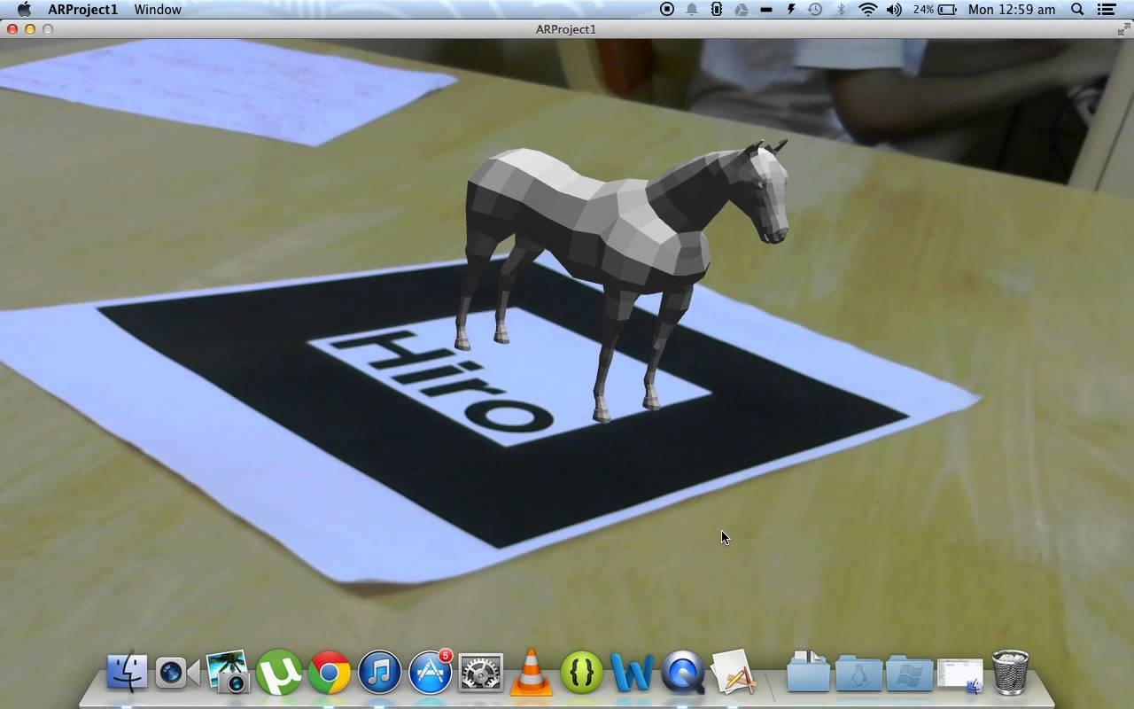
Problems Encountered
Limited libraries with AR capabilities for Web
Location accuracy

Slide 7
Goals for Sprint 2
Product owner: Adithya Raghuraman
Search and locate places of interest
Get in-depth info about place of interest selected
Create user profile capabilities (registration, login, etc.)
View friends and their suggestions on AR Map.

Slide 8
Thank You
Questions?

